Slide 1

Net4j Signalling Platform 2.0 Release Review
Eike Stepper
stepper@esc-net.de
http://www.esc-net.de
http://thegordian.blogspot.com
Berlin, Germany
Planned Review Date:
Project Newsgroup:
June 10th, 2009
eclipse.tools.emf

Slide 2
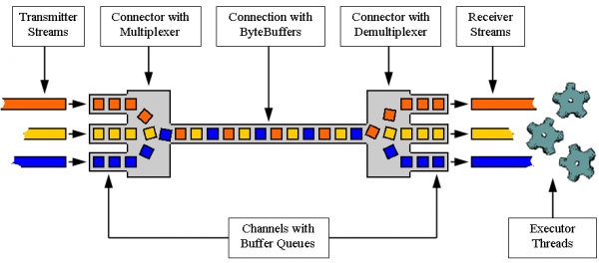
Introduction
The Net4j Signalling platform is an extensible client/server communications framework. Net4j eases the development of fast and maintainable application protocols that are independent of the physical transport medium. Transport protocols are pluggable and Net4j ships with support for TCP, HTTP and in-memory transport. The core of Net4j is a fast, asynchronous and non-blocking buffer multiplexing kernel, based on OSGi but also executable stand-alone.
Project URL:
http://wiki.eclipse.org/Net4j

Slide 3
Major New Features in 2.0
New features:
28 total
IPluginContainer independent of OSGi
Provide a HeartBeatPotocol
Easier configuration of authentication
Improved exception handling
Proper RemoteExceptions
Connector.openChannel with configurable timeout
Asynchronous progress monitoring over the network
IP address available during negotiation
Hsqldb database supported
Postgresql database supported
H2 database supported

Slide 4
Other Release Highlights
Quality of APIs
2.0 API is partly incompatible with 1.0
API Toling has been used consequently
End of Life
None
IP
IP Log URL: http://www.eclipse.org/modeling/emf/net4j/project-info/eclipse-project-ip-log.csv
No issues
Committer Diversity
7 committers from 7 different companies
Several additions to the team are pending

Slide 5
Project Activity Since 1.0
Bugzilla
28 of 42 enhancements done (10 left open)
13 of 20 bugs fixed (4 left open)
CVS
44187 changed lines of code committed (incl. CDO)
Communication
More than 120 newsgroup posts
Talk at EclipseCon, several demo camps
Several magazine articles

Slide 6
Schedule
Galileo
All release train schedules were met
Weekly integration builds on modeling update site
Ganymede
9 maintenance builds were delivered
Including SR1 and SR2
Plan URL
http://www.eclipse.org/projects/project-plan.php?planurl=http://www.eclipse.org/modeling/emf/net4j/project-info/plan.xml&component=Net4j+Signalling+Platform

